Slide 1
WHMxx0A EMC test
FW upload Manual
IoT사업부 연구1파트
2024. 08. 19

Slide 2
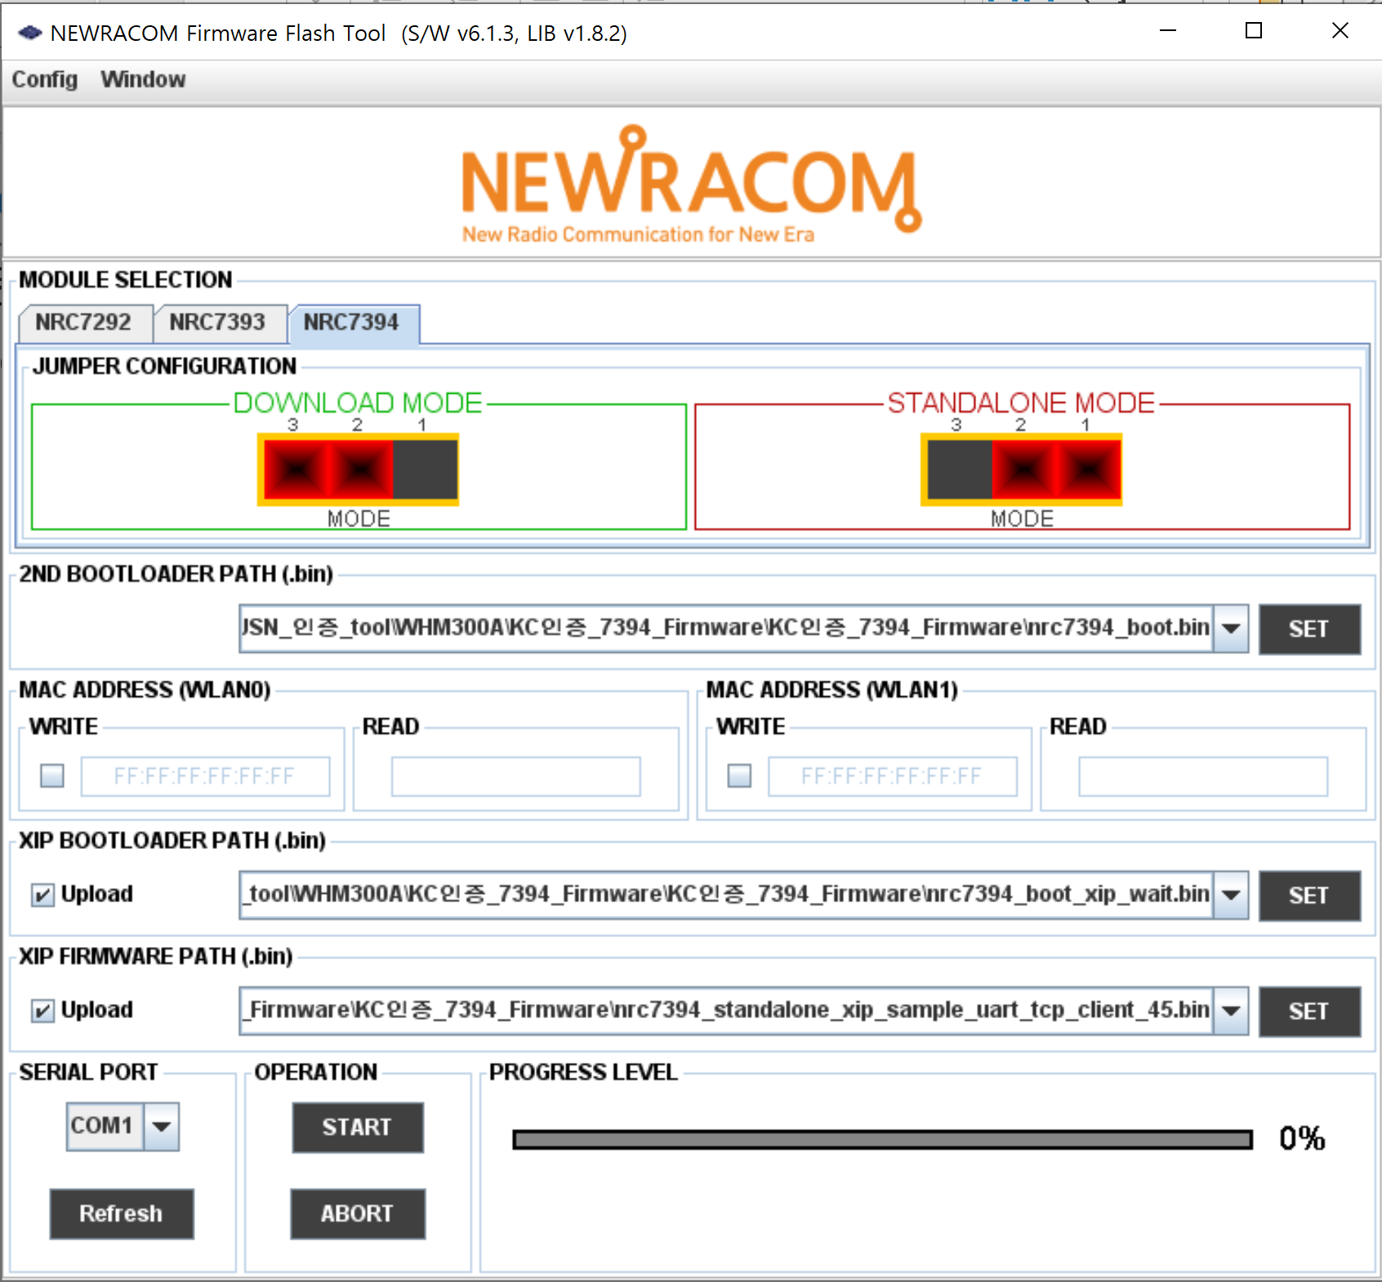
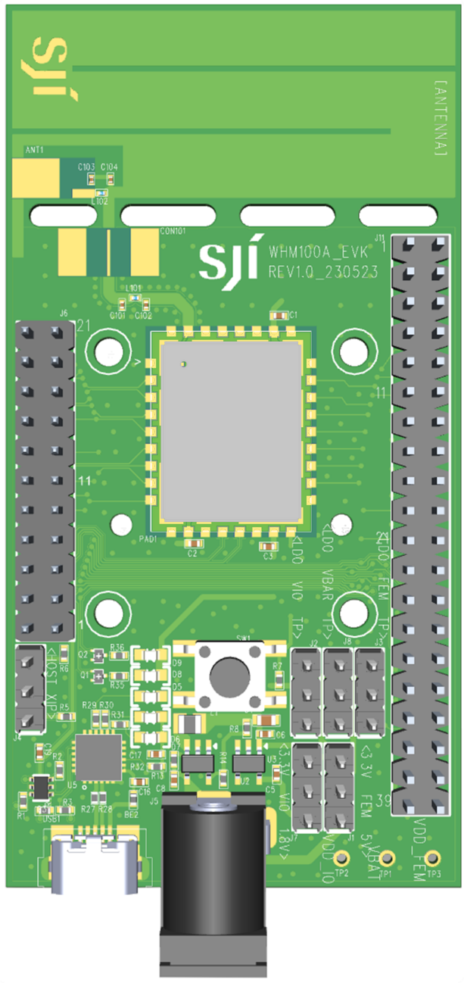
Mode Setting
- Download
> Header HOST
- AP- STA test
> Header XIP
< HOST
< XIP

Slide 3
STA FW upload
- Run FirmwareFlashTool.exe
> STA FW upload
Boot File setting : nrc7394_boot.bin
Boot_XIP File setting : nrc7394_boot_xip_wait.bin
AP 용 bin File setting : nrc7394_standalone_xip_sample_uart_tcp_client_45.bin
Comport refresh
Start
1
2
3
4
5

Slide 4

AP FW upload
- Run FirmwareFlashTool.exe
> AP FW upload
Boot File setting : nrc7394_boot.bin
Boot_XIP File setting : nrc7394_boot_xip_wait.bin
AP 용 bin File setting : nrc7394_standalone_xip_sample_softap_uart_tcp_server_relay.bin
Comport refresh
Start
1
2
3
4
5

Slide 5
T-Put TEST
Iperf Command
STA : iperf -s -i 1
AP : iperf -c 192.168.200.89 -i 1 -t 100
//You can adjust the t-put measurement time from 1 second to 100 seconds.

Slide 6
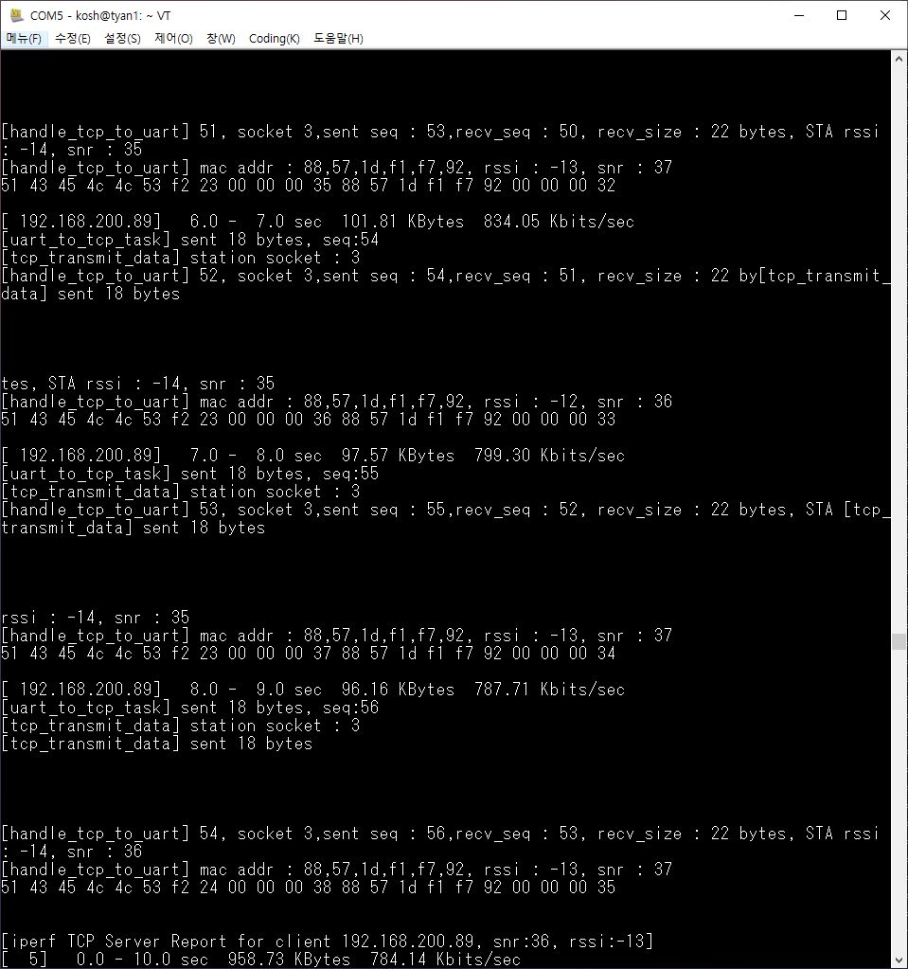
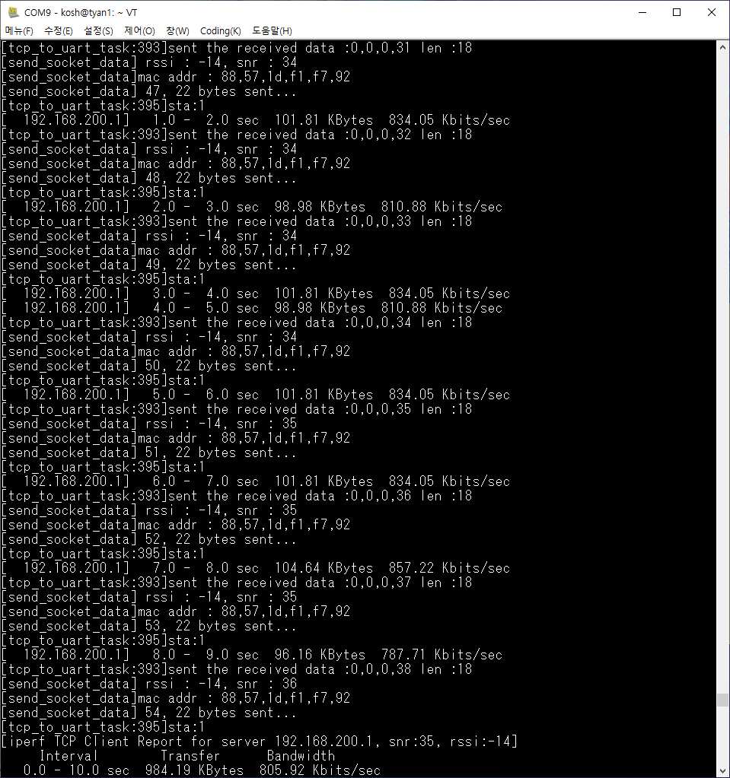
T-Put TEST Log
< T-Put Check
< T-Put Check

Slide 7
감사합니다.

